Slide 1

Customer churn prediction in Telecom industry using Machine Learning algorithms in Python

Slide 2

Introduction
Telecom industry is growing at a rapid pace . The customer base is increasing every year. More customers means larger chunk of the market which results in high revenue margin.
Some important Market statistics of this highly competitive market
At the end of 2018 there were an estimated 6.28 million mobile subscriptions, up 0.7 per cent on the prior quarter. Of these, 4.7 million were using 3G and/or 4G networks.
Fixed broadband subscriptions rose 0.8 per cent nationwide rose to 1.73 million.
VDSL subscriptions increased from 27.2% to 35.8%,.
DSL accounted for 17.1% of all subscriptions over
Fiber to Home (FTTH) subscriptions rose 129% over the previous year.

Slide 3
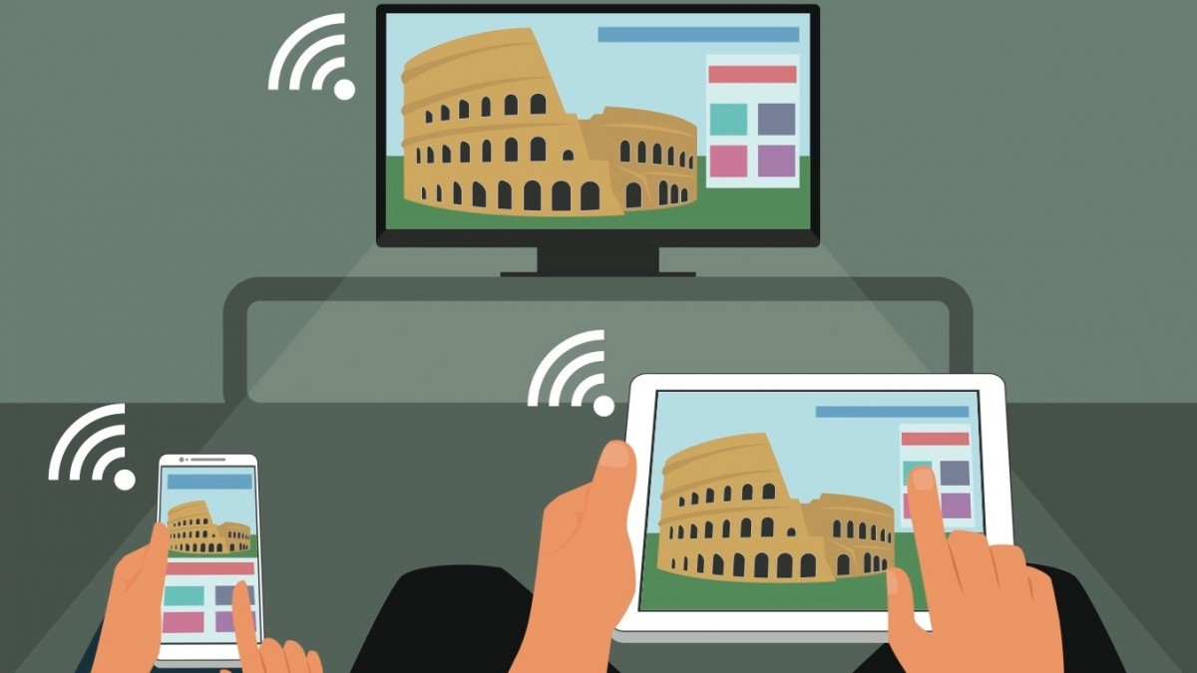
The problem statement
Customer preferences being highly volatile results in a telecom company facing an uphill task in retaining the existing customers. Every year companies are loosing thousands of customers. This makes it a highly competitive space.
The key players in this market are Vodafone, Eir, Virgin Media, Sky Ireland and Tesco who are constantly striving hard to retain existing customers and acquire new ones.
Every customer is different and has different pre requisites so a common strategy is not always adequate enough.
So is there a way to figure out which customer might leave and what can be done to retain that customer ?

Slide 4
Solving the problem
Building a new Predictive Adherence system
Accurately assess and predict who has maximum chances of leaving ? Identify what influences the Churn factor - What data‐driven factors are materially affecting adherence levels? Based on the above results, start with offers and Rewards.

Slide 5
Solving the problem
Building a new Predictive Adherence system
Accurately assess and predict who has maximum chances of leaving ? Identify what influences the Churn factor - What data‐driven factors are materially affecting adherence levels? Based on the above results, start with offers and Rewards.

Slide 6



Primary Stake-Holders
Primary Stakeholders
Telecom Companies
Throttle overall sales.
Increased customer engagement
Limited risk of ill-effects
Flexibility to scale up
Telecom Companies
Throttle overall sales.
Increased customer engagement
Retain maximum customers
Flexibility to scale up
Consumers
Improved overall quality of healthcare.
Mitigate risk of re-hospitalizations.
Decreased costs of healthcare.
Consumers
Cost efficient
Better calling and internet services.
Value added service

Slide 7
Primary Stake-Holders
Solving the problem
Telecom Companies
Throttle overall sales.
Increased customer engagement
Limited risk of ill-effects
Flexibility to scale up
Raw Data
Math model (Using Python)
Consumer churn list
Consumers
Improved overall quality of healthcare.
Mitigate risk of re-hospitalizations.
Decreased costs of healthcare.

Slide 8



Persona
Melissa and John
Age 24 and 26
Large friend circle
More mobile communication with people
Internet for entertainment (Music, Videos ,skype, social network and education.
Streaming platforms like Amazon Prime, Netflix, YouTube
Usage of multiple internet based gadgets
High expectations from the service provider at affordable rates
Peter and Aoife
Age 65 and 62
Not too social
Using phone for basic purpose like calling and texting
Limited internet usage
Moderate expectations
Limited use of internet based gadgets

Slide 9
Solution Demo

Slide 10

Solutions
85% of the customers of the Telecom operator are young people below the age of 60 , so the telecom operator should design bulk of its strategies and plans that will attract this particular segment. This may include providing incentives like reward points, budget friendly mobile internet packs, or entertainment packs (like sports or movies packs) at a lower rate which will pull the crowd.
The churn rate is high among people having no partners or dependencies as they are more prone to jump telecom operators. Now to retain customers off such category it is important to provide offers that holds the interest of the operator like membership to fitness clubs , free diner passes, or membership at discounted rates to dating apps after a certain duration with the telecom operator.
Phone services like call quality, network coverage needs to be improved as the purchasing power of the economy is increasing so is the impatience level. It is necessary to ensure that the basic requirements of the customers are fulfilled.

Slide 11

Data Cleaning and Preparation for modeling
1. Treat Outliers & Missing Values
5. Drop Unwanted columns
2.Feature Engineering
4. Convert Categorical Variables to binary dummies
3. Create Definition for dependent variable

Slide 12

Phone services like call quality, network coverage needs to be improved as the purchasing power of the economy is increasing so is the impatience level. It is necessary to ensure that the basic requirements of the customers are fulfilled.
The company should focus on providing online security and device security at lower rates so as to get the confidence of the customers , to ensure that they are well taken care of.
Provide better technical support as and when needed by customers thus ensuring better customer service.
Provide popular streaming TV content and channels that catches the attention of the customers. Broadcast latest movies and TV shows that is trending so that customers interest can be captured.
Majority of the customers are on monthly contracts. High prices causes consumers to explore other cheaper alternatives. So the company should look forward to reduce the price of the monthly contracts to capture greater section of the market as well as retain existing consumers.

Slide 13

Thank you

Slide 14


